Slide 1


COEN 79
OO Programming and Data Structures in C++
Lab 1

Slide 2
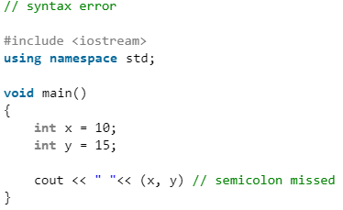
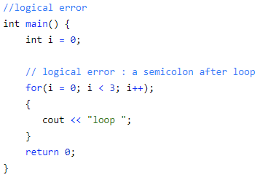
Syntax Error:
Logical Error:
Violating the rules of writing C/C++ syntax
Compiler will indicate this kind of error
Cannot obtain desired output

Slide 3
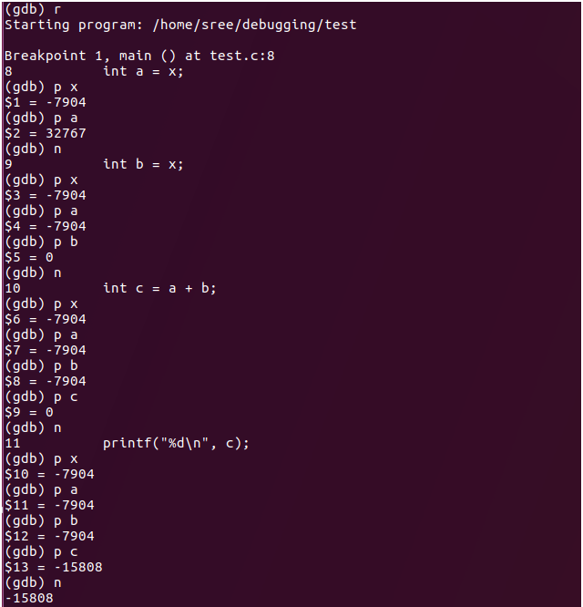
WHAT is DEBUG?
Execute code step by step
Monitor every detail during execution (variable value, function calls, etc.)

Slide 4
GNU Symbolic Debugger

Slide 5
In general, the GDB has the following functions:
Programs can be runed with customized requirements, such as parameters and environment variables;
It supports breakpoint debugging (The program can be paused at specified point and view the state of the current program (such as the value of variables, the execution result of the function, etc.));
During program execution, you can change the value of a variable or the execution order of the code, so as to try to modify the logical errors in the program.

Slide 6
DEMO

Slide 7
Create a ‘debuggable’ execution file:
g++ demo.cpp –o demo.exe -g
Initialize the debugging:
gdb demo.exe -silent
Notes:
The execution file must contain necessary debugging information (such as the line number, the list containing the names of all variables in the program (also known as symbol table), etc.)
A bunch of disclaimers will be printed while starting GDB. By adding the --silent (or -q, --quiet) option, some information can be discarded.

Slide 8
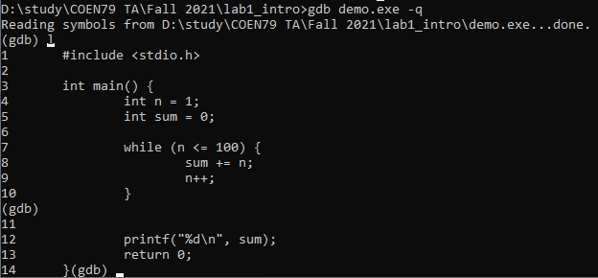
list:
Displays the content of the source code, including the line number.
Notes:
By default, the ‘list’ option displays only 10 lines of source code. If you want to view subsequent codes, just press enter.

Slide 9
break:
break XXX: insert breakpoint at the specific line
tbreak XXX: insert a temporary breakpoint (triggered only once) at the specific line
break XXX if Cond: insert a conditional breakpoint (only triggered when the condition is True) at the specific line
Notes:
XXX could be a line number or an offset relative to the current position

Slide 10
watch:
Only when the value of the monitored variable (expression) changes will the program stop running
catch:
Monitoring the occurrence of an event in the program, such as when an exception occurs in the program, when a dynamic library is loaded, etc. Once the target event occurs, the program stops running
Notes:
rwatch: when the value of the target variable (expression) is read, the program will stop running;
awatch: when the value of the target variable (expression) is read or changed, the program will stop running.
tcatch: same as tbreak

Slide 11
run:
Execute the debugged program, and will automatically stop running at the first breakpoint.
continue:
When the program stops running at a breakpoint, the instruction can be used to resume execution until the next breakpoint or the end of the program.
quit:
Stop debugging.

Slide 12
next, step:
‘next’ treats the function call as a line of code and will not enter the function;
‘step’ will enter the function and stay at the first line of code (the code will not be executed);
Check existing breakpoints and delete them:

